Slide 1
NMF and Image zipping
Step by step improvement makes perfect
Haoen Huang 2024-10-22

Slide 2
NMF
Non-negative matrix decomposition
Given A with
$$A_{ij}>0$$
=
$$\underset{0<w_{ij}∈W,0<h_{ij}∈H}{argmin}f(W,H)=∥A-WH∥_{F}^{2}$$
$$\underset{m×n}{A}$$
$$\underset{m×r}{W}$$
$$\underset{r×n}{H}$$
$$∥M∥_{F}=\sqrt{\overset{N}{\underset{i=1}{∑}}\overset{M}{\underset{j=1}{∑}}m_{ij}^{2}}$$
F-norm:

Slide 3
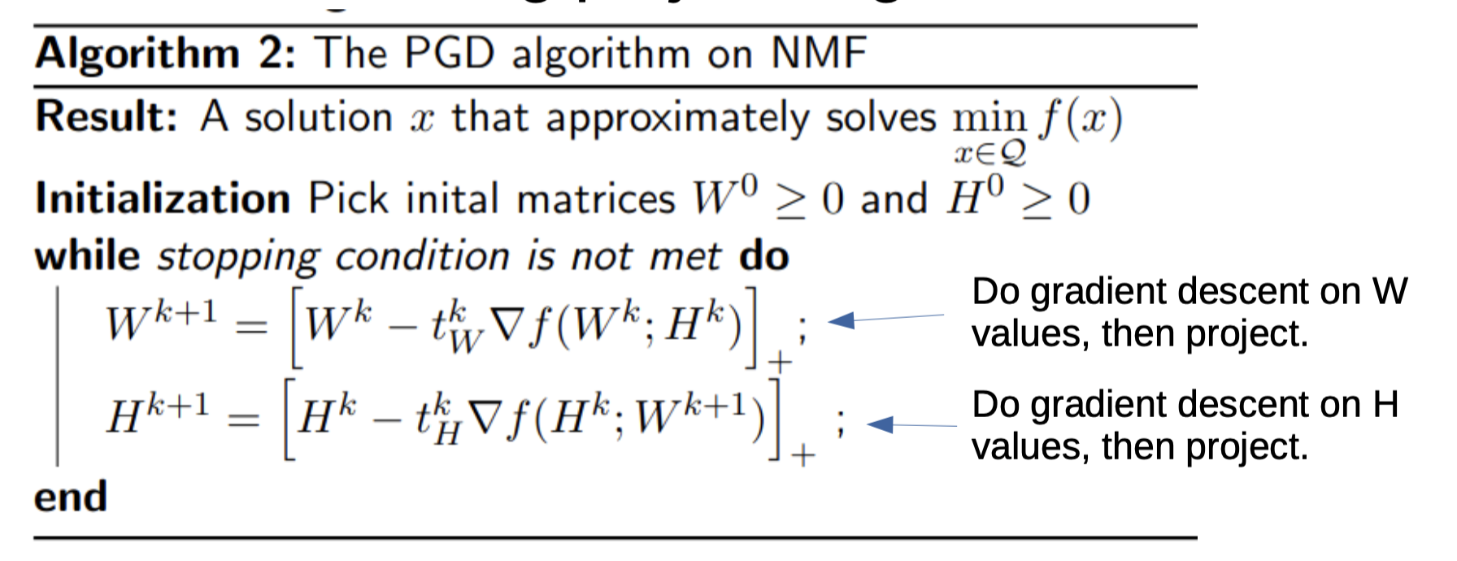
NMF
Projected Gradient Descent methods(Andersen Ang)
$$∇_{W}f(W,H)=(WH-X)H^{T}$$
$$∇_{H}f(W,H)=W^{T}(WH-X)$$
$$t_{W}^{k}=\frac{1}{∥HH^{T}∥_{2}},t_{H}^{k}=\frac{1}{∥W^{T}W∥_{2}}$$
$$\underset{0<w_{ij}∈W,0<h_{ij}∈H}{argmin}f(W,H)=∥A-WH∥_{F}^{2}$$

Slide 4
NMF
$$\underset{0<w_{ij}∈W,0<h_{ij}∈H}{argmin}f(W,H)=\frac{1}{2}∥A-WH∥_{F}^{2}$$
Coordinate descent methods(Bindel)
$$R=A-WH$$
$$\frac{1}{2}∥A-(W+se_{i}e_{j}^{T})H∥_{F}^{2}=\frac{1}{2}∥R∥_{F}^{2}-s⟨(e_{i}e_{j}^{T}),RH^{T}⟩_{F}+\frac{1}{2}s^{2}∥e_{i}e_{j}^{T}H∥_{F}^{2}$$
$$s=max\left(-w_{ij},\frac{(RH^{T})_{ij}}{(HH^{T})_{jj}}\right),w_{ij}:=w_{ij}+s,R_{i,:}:=R_{i,:}-sH_{j,:}$$
$$s=max\left(-h_{ij},\frac{(W^{T}R)_{ij}}{(W^{T}W)_{ii}}\right),h_{ij}:=h_{ij}+s,R_{:,j}:=R_{:,j}-sW_{:,i}$$

Slide 5




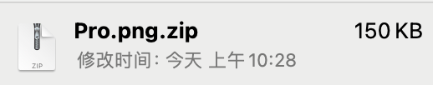
Application: Image Zipping
=
$$\underset{600×600}{A}$$
$$\underset{600×r}{W}$$
$$\underset{r×600}{H}$$
$$\underset{600×600}{\text{reconstruct}A}$$
$$\frac{2×r×600}{600×600}=\frac{r}{300}$$
Zip it?

Slide 6



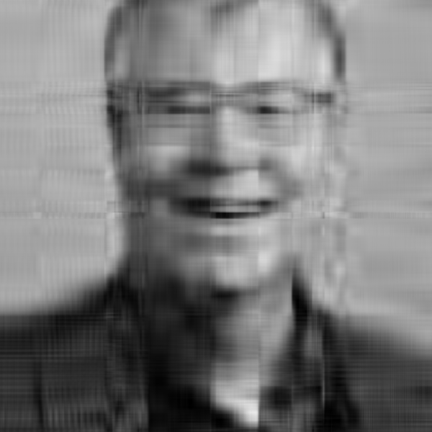


Results
$$\underset{m×n}{A}=\underset{m×r}{W}×\underset{r×n}{H}$$
r = 10
r = 100
r = 200
Original
PGD
r = 10
r = 40
r = 100
CD

Slide 7
Time(s)
$$\underset{m×n}{A}=$$
$$\underset{m×r}{W}×$$
$$\underset{r×n}{H}$$
Machine: ASUS ROG Zephyrus G14, CPU: AMD Ryzen9 7940HS, 16 RAM, GPU: RTX4060 8GB
r | 10 | 20 | 30 | 40 | 50 | 60 | 70 | 80 | 90 | 100 | 150 | 200 | 250 | 300
GSD | 25 | 98 | 223 | 232 | 231 | 475 | 373 | 304 | 639 | 740 | 653 | 778 | 848 | 949
CD | 76 | 899 | 1437 | 3780 | 5761 | 2143 | 4942 | 6260 | 9770 | 5284
Lin's | 10 | 25 | 33 | 31 | 49 | 29 | 42 | 29 | 9 | 7 | 4 | 4 | 8 | 7

Slide 8
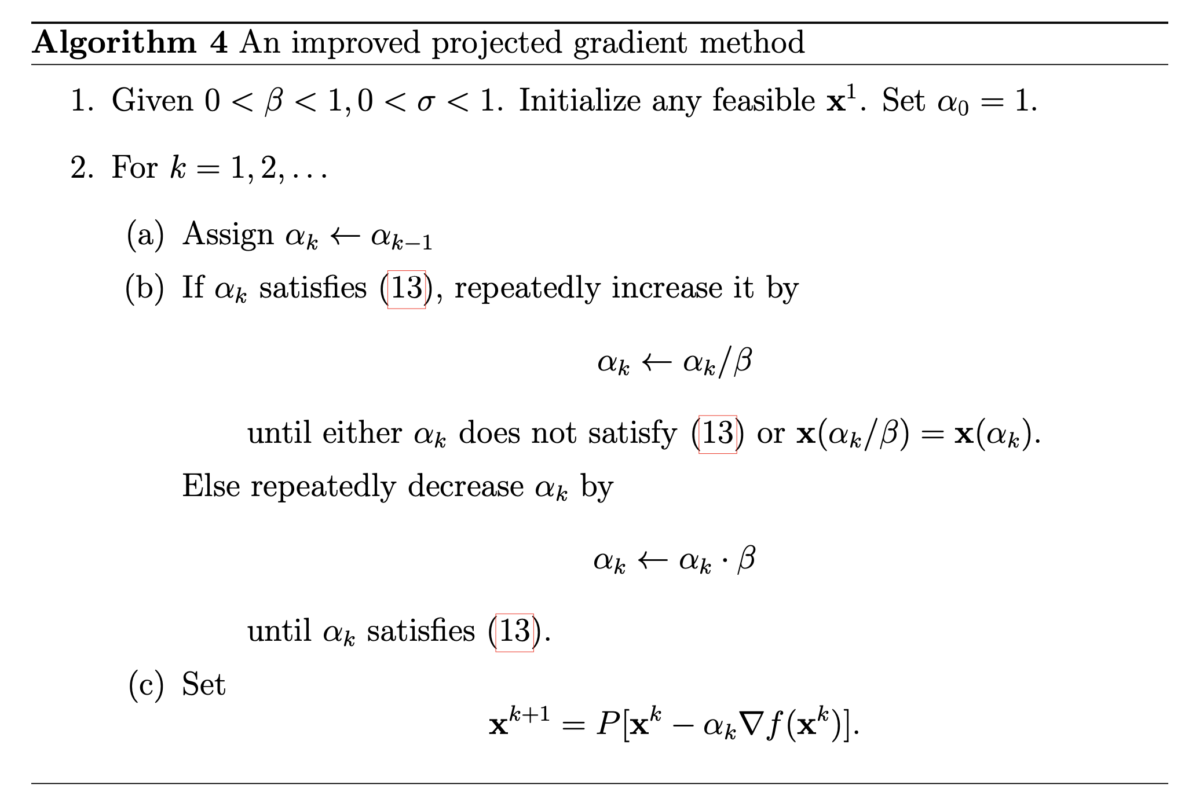
From Lin’s method
Stopping condition
$$∥∇^{P}f(W^{k},H^{k})∥_{F}≤ϵ∥∇f(W^{1},H^{1})∥_{F}$$
Backstepping?
$$t_{W}^{k}=\frac{1}{∥HH^{T}∥_{2}},t_{H}^{k}=\frac{1}{∥W^{T}W∥_{2}}$$

Slide 9
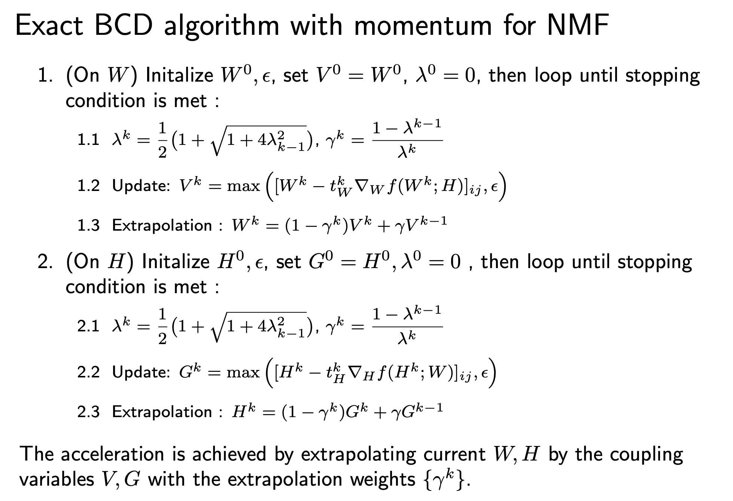
From Ang’s method
$$∇_{W}f(W,H)=WHH^{T}-XH^{T}$$
$$∇_{W}^{New}f(W,H)=∇_{W}^{old}f(W,H)+$$
$$(W^{new}-W^{old})HH^{T}$$
$$t_{W}^{k}=\frac{1}{∥HH^{T}∥_{2}},t_{H}^{k}=\frac{1}{∥W^{T}W∥_{2}}$$
Fix step size

Slide 10
Time(s)
$$\underset{m×n}{A}=$$
$$\underset{m×r}{W}×$$
$$\underset{r×n}{H}$$
Machine: ASUS ROG Zephyrus G14, CPU: AMD Ryzen9 7940HS, 16 RAM, GPU: RTX4060 8GB
r | 10 | 20 | 30 | 40 | 50 | 60 | 70 | 80 | 90 | 100 | 150 | 200 | 250 | 300
GSD | 25 | 98 | 223 | 232 | 231 | 475 | 373 | 304 | 639 | 740 | 653 | 778 | 848 | 949
CD | 76 | 899 | 1437 | 3780 | 5761 | 2143 | 4942 | 6260 | 9770 | 5284
Lin's | 10 | 25 | 33 | 31 | 49 | 29 | 42 | 29 | 9 | 7 | 4 | 4 | 8 | 7
Myresult | 16 | 11 | 32 | 7 | 61 | 2.8 | 5.3 | 5 | 8.6 | 8.4 | 5.8 | 7.37 | 11.44 | 12.36

Slide 11


One more step
{
R
$$\underset{600×r}{W}$$
$$\underset{r×600}{H}$$
=
G
$$\underset{600×r}{W}$$
$$\underset{r×600}{H}$$
B
$$\underset{600×600×3}{A}$$
$$\underset{600×600×3}{\text{reconstruct}A}$$
$$\underset{600×r}{W}$$
$$\underset{r×600}{H}$$
$$\frac{2×r×600×3}{600×600×3}=\frac{r}{300}$$

Slide 12
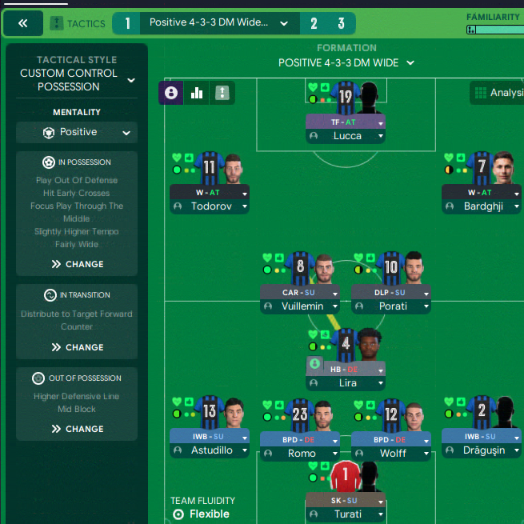
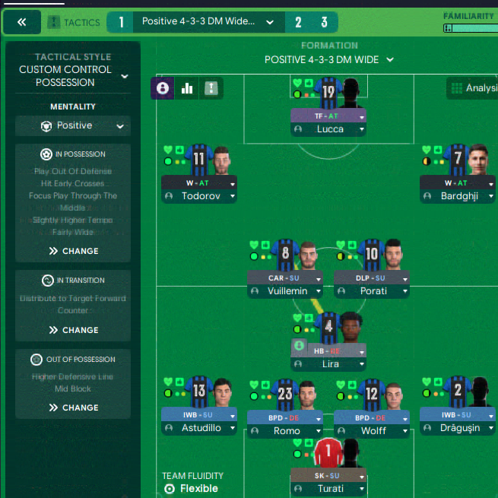
One more step
{
R
$$\underset{600×r}{W}$$
$$\underset{r×600}{H}$$
=
G
$$\underset{600×r}{W}$$
$$\underset{r×600}{H}$$
B
$$\underset{600×600×3}{A}$$
$$\underset{600×600×3}{\text{reconstruct}A}$$
$$\underset{600×r}{W}$$
$$\underset{r×600}{H}$$
$$\frac{2×r×600×3}{600×600×3}=\frac{r}{300}$$

Slide 13
Future work
$$\underset{m×n}{A}=$$
$$\underset{m×r}{W}×$$
$$\underset{r×n}{H}$$
More datasets experiments
Parallel computing
The best r?

Slide 14
Reference
Nonnegative Matrix Factorization via (alternating) Projected Gradient Descent, Andersen Ang.
Projected Gradient Methods for Non-negative Matrix Factorization, Chih-Jen Lin
Non-negative Matrix Factorization (NMF), Bindel, Summer 2018

Slide 15
Code demo and Question time
The code and results are available on https://github.com/GhostBlue32/Algorithm-For-Op/tree/main/MidProject/NMF.

Slide 16
r=10
PGD

Slide 17

r=20
PGD

Slide 18

r=40
PGD

Slide 19

r=70
PGD

Slide 20
r=100
PGD

Slide 21

r=150
PGD

Slide 22
r=200
PGD

Slide 23

r=300
PGD
Back

Slide 24
r=10
CD

Slide 25

r=20
CD

Slide 26

r=40
CD

Slide 27

r=80
CD

Slide 28
r=100
CD
Back

Slide 29

r=10
Lin’s

Slide 30

r=20
Lin’s

Slide 31

r=40
Lin’s

Slide 32

r=70
Lin’s

Slide 33

r=100
Lin’s

Slide 34

r=150
Lin’s

Slide 35

r=200
Lin’s

Slide 36

r=300
Lin’s
Back

Slide 37

r=10
My

Slide 38

r=20
My

Slide 39

r=40
My

Slide 40

r=70
My

Slide 41

r=100
My

Slide 42

r=150
My

Slide 43

r=200
My

Slide 44

r=300
My
Back

Slide 45

r=100
My

Slide 46

r=150
My

Slide 47

r=175
My

Slide 48

r=200
My

Slide 49

r=300
My
Back

